Slide 1
DIVIDE AND CONQUER
12/26/2023
CS112.O11.KHTN
Team 10

Slide 2
TABLE OF CONTENTS
01
02
03
12/26/2023
PROBLEM
GENERAL IDEA
04
WHY?
COMPLEXITY
05
06
EXAMPLE
Q&A

Slide 3

CEO
12/26/2023
Suppose Nam is the CEO of a large company who wants to evaluate the performance of all employees in the company. The company has thousands of employees, so how will you evaluate the performance of all employees?
Notes:
CEO có thể sử dụng thuật toán chia để trị để giải quyết bài toán này.
Đầu tiên, CEO có thể chia công ty thành các bộ phận nhỏ, chẳng hạn như bộ phận kinh doanh, bộ phận tiếp thị, bộ phận kỹ thuật,...
Sau đó, CEO có thể giao nhiệm vụ đánh giá hiệu suất của nhân viên trong từng bộ phận cho trưởng bộ phận.
Trưởng bộ phận có thể sử dụng các phương pháp đánh giá hiệu suất khác nhau, chẳng hạn như đánh giá 360 độ, đánh giá hiệu suất dựa trên mục tiêu,...

Slide 4
TABLE OF CONTENTS
01
02
03
12/26/2023
PROBLEM
GENERAL IDEA
04
WHY?
COMPLEXITY
05
06
EXAMPLE
Q&A

Slide 5
01
PROBLEM
12/26/2023

Slide 6
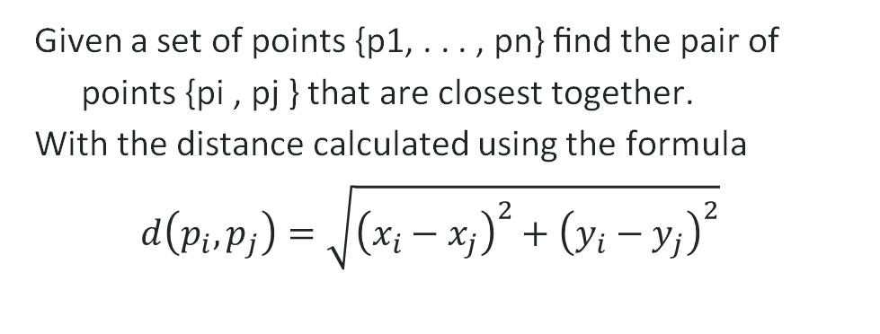
Finding a closest pair of points
01
PROBLEM
12/26/2023
Given a set of points {p1, . . . , pn} ﬁnd the pair of points {pi , pj } that are closest together.
With the distance calculated using the formula
$$d\left(p_{i},p_{j}\right)=\sqrt{{\left(x_{i}−x_{j}\right)}^{2}+{\left(y_{i}−y_{j}\right)}^{2}}$$

Slide 7
BRUTEFORCE
01
PROBLEM
12/26/2023
Check every pair of points
// A Brute Force method to return the
// smallest distance between two points
// in P[] of size n
float bruteForce(Point P[], int n)
{
float min = FLT_MAX;
for (int i = 0; i < n; ++i)
for (int j = i+1; j < n; ++j)
if (dist(P[i], P[j]) < min)
min = dist(P[i], P[j]);
return min;
}

Slide 8
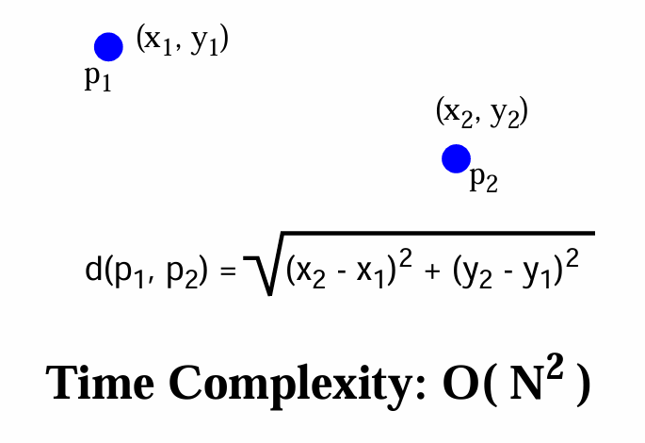
01
PROBLEM
12/26/2023

Slide 9
Can we do it faster?
01
PROBLEM
12/26/2023
Notes:
In fact, we can find the closest pair in O(nlogn) time

Slide 10

02
GENERAL IDEA
12/26/2023

Slide 11

DIVIDE AND CONQUER
02
GENERAL IDEA
12/26/2023

Slide 12
DIVIDE AND CONQUER
02
GENERAL IDEA
12/26/2023
Divide: This involves dividing the problem into smaller sub-problems.
Conquer: Solve sub-problems by calling recursively until solved.
Combine: Combine the sub-problems to get the final solution of the whole problem.

Slide 13
DIVIDE AND CONQUER
02
GENERAL IDEA
12/26/2023

Slide 14
Finding a closest pair of points
02
GENERAL IDEA
12/26/2023
Apply the idea of “divide and conquer”:
1. Divide N points to be processed into 2 sets with a vertical line
2. Call recursively to find the closest pair of points for the left set and the right set
3. Find the shortest distance between a point in the left set and a point in the right set.

Slide 15
Divide and Conquer
02
GENERAL IDEA
12/26/2023
1. Split the points with line L so that half the points are on each side. 2. Recursively ﬁnd the pair of points closest in each half.
d
left
d
right
L

Slide 16
Combine: the hard case
02
GENERAL IDEA
12/26/2023
Let d = min{d_{left}, d_{right}}.
d would be the answer, except maybe L split a close pair!

Slide 17
Region Near L
02
GENERAL IDEA
12/26/2023
If there is a pair {pi , pj } with dist(pi , pj ) < d that is split by the line, then both pi and pj must be within distance d of L.
d
L

Slide 18

Pseudo code
02
GENERAL IDEA
12/26/2023
DAC(a, i, j)
{
if(small(a, i, j))
return(Solution(a, i, j))
else
mid = divide(a, i, j) // f1(n)
b = DAC(a, i, mid) // T(n/2)
c = DAC(a, mid+1, j) // T(n/2)
d = combine(b, c) // f2(n)
return(d)
}

Slide 19
IDENTITY
02
GENERAL IDEA
12/26/2023
Divide: Can the problem be divided into smaller sub-problems of the same type?
Conquer: Can the sub-problems be directly solved when they are small enough?
Combine: Can the solutions of the sub-problems be combined to form a solution for the original problem?
Examples: binary search, quick-sort…

Slide 20
Finding a closest pair of points
02
GENERAL IDEA
12/26/2023
Divide
Conquer
Combine
d
left
d
right
L

Slide 21
Variation of DAC
02
GENERAL IDEA
12/26/2023
1. Dynamic Programming
Divide large problems into overlapping sub-problems and optimal sub-structures.
These problems often have many correct solutions and each solution has 1 evaluation value

Slide 22

Variation of DAC
02
GENERAL IDEA
12/26/2023
2. Decrease and conquer
A technique used to solve problems by reducing the size of the input data at each step of the solution process
Ex: binary search,..

Slide 23
Variation of DAC
02
GENERAL IDEA
12/26/2023
3. Transform and conquer
The problem-solving strategy of "Transform and Conquer" involves dividing the problem into smaller parts and transforming the data or structure of the original problem into a simpler form to solve it more effectively.

Slide 24

03
WHY?
12/26/2023

Slide 25

Advantages
03
WHY?
12/26/2023
Efficiency
Parallelization
Modularity
Algorithmic reusability
Solving large instances
Optimality
Notes:
Efficiency: Divide and Conquer algorithms often provide efficient solutions to problems. By breaking down a problem into smaller parts, the algorithm can reduce the overall time complexity of the solution. This is especially true for problems with a high time complexity, where dividing the problem into smaller subproblems can significantly improve the efficiency of the algorithm.
Parallelization: The Divide and Conquer approach is inherently parallelizable, making it well-suited for parallel and distributed computing environments. Since subproblems can be solved independently, multiple processors or computing resources can work on different subproblems simultaneously, leading to faster overall computation and improved scalability.
Modularity: The algorithm promotes modularity by dividing a complex problem into manageable subproblems. Each subproblem can be solved separately and then combined with other subproblem solutions to obtain the final result. This modular structure not only simplifies the understanding and implementation of the algorithm but also allows for easier maintenance and code reuse.
Algorithmic reusability: The Divide and Conquer approach is often based on recurring patterns. Once a general divide and conquer algorithm is designed, it can be applied to problems with similar characteristics. This reusability of the algorithmic structure can save time and effort in solving various related problems.
Solving large instances: Divide and Conquer algorithms are particularly useful when dealing with large problem instances. By dividing the problem into smaller subproblems, the algorithm can handle larger inputs more efficiently. This scalability makes it possible to solve problems that would be impractical or impossible using other approaches.
Optimality: In many cases, Divide and Conquer algorithms produce optimal solutions. By solving subproblems optimally and combining the results correctly, the algorithm can guarantee an optimal solution for the overall problem. This property is particularly valuable in optimization problems where finding the best solution is crucial

Slide 26
Disadvantages
03
WHY?
12/26/2023
Extra Memory Usage
Difficulty Handling Some Problems
Suboptimal Solutions
Not Always Stable
Potential for Overlapping Subproblems
Notes:
Extra Memory Usage: In some cases, the divide and conquer approach requires additional memory to store intermediate results during the recursive process. This can be a disadvantage, especially when dealing with large input sizes or limited memory resources.
Difficulty Handling Some Problems: Not all problems can be easily solved using the divide and conquer paradigm. Some problems may not have a natural division, or the division process may introduce additional complexities that make the algorithm less efficient or harder to implement correctly.
Suboptimal Solutions: The divide and conquer strategy sometimes guarantees the most optimal solution. Although it often leads to efficient solutions, there are cases where alternative algorithms can outperform divide and conquer approaches in terms of time or space complexity.
Not Always Stable: Divide and conquer algorithms may not preserve the order of elements in the input. If maintaining order is crucial for a specific problem, the divide and conquer approach may require additional steps to ensure the stability of the solution, leading to extra complexity.
Potential for Overlapping Subproblems: Some divide and conquer algorithms may encounter overlapping subproblems, meaning that the same subproblem is solved multiple times. Without proper techniques to handle overlapping subproblems, the algorithm can become inefficient due to redundant computations

Slide 27
Compare “Divide and Conquer” and “Brute Force”
03
WHY?
12/26/2023
Feature | Divide and Conquer | Brute Force
Efficiency | Typically more efficient for large or complex problems | Typically less efficient for large or complex problems
Approach | Breaks a problem down into smaller subproblems | Tries every possible solution
Complexity | Often has a logarithmic time complexity (O(log n) or On(log n)) | Often has a linear time complexity (O(n) or O(n^2))
Examples | Binary search, merge sort, quick sort | Bubble sort, insertion sort, selection sort

Slide 28
04
COMPLEXITY
12/26/2023

Slide 29
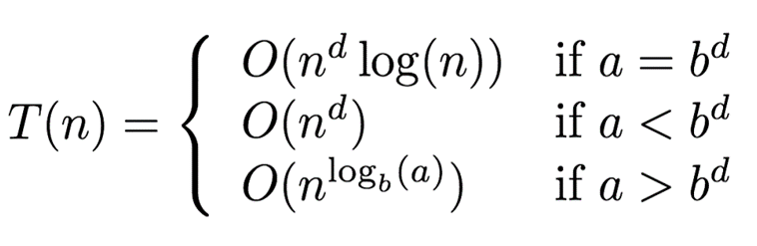
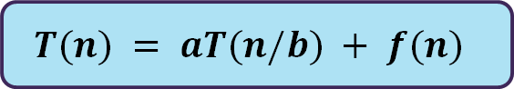
The recurrence
04
COMPLEXITY
12/26/2023
$$T(n) = aT(n/b) + f(n)$$
where n = size of the problem a = number of subproblems in the recursion and a >= 1 n/b = size of each subproblem f(n) = cost of work done outside the recursive calls like dividing into subproblems and cost of combining them to get the solution.

Slide 30
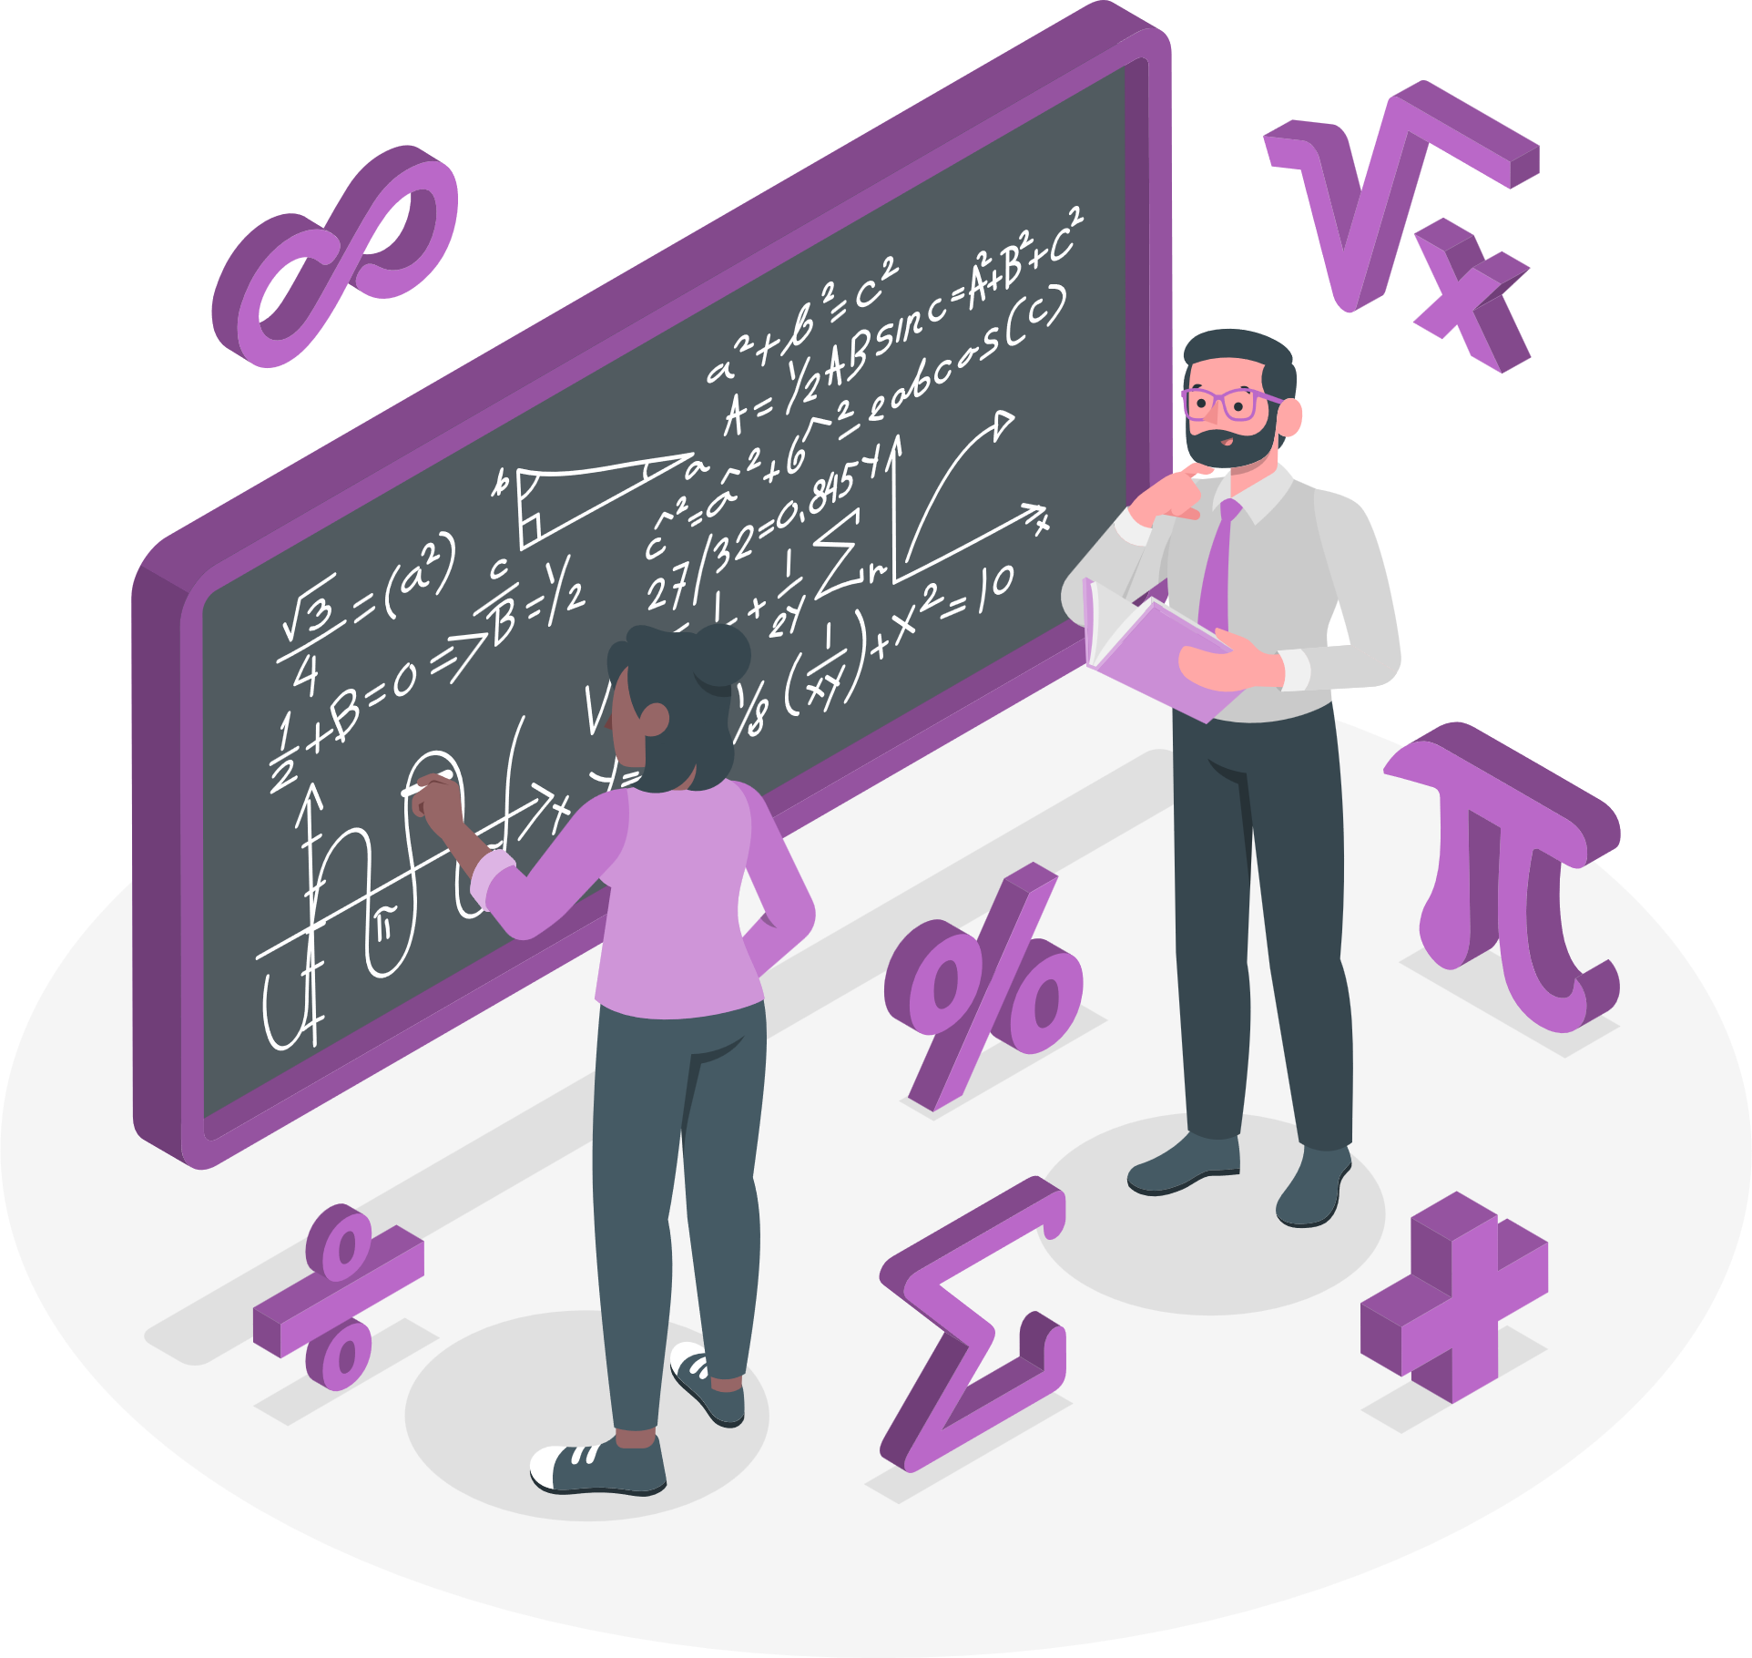

Master theorem
04
COMPLEXITY
12/26/2023

Slide 31
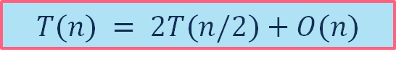

Finding a closest pair of points
04
COMPLEXITY
12/26/2023
Classic divide and conquer recurrence:
$$T(n) = 2T(n/2)+O(n)$$
Apply Master Theorem, we have complexity is:
$$O(nlogn)$$
Notes:
Thuật toán chia tập hợp điểm thành hai nửa, mỗi nửa có kích thước là n/2. Do đó, chúng ta có hai lần thực hiện thuật toán với kích thước n/2, dẫn đến 2𝑇(𝑛/2).
Sau đó, thuật toán kết hợp các kết quả từ các bài toán con. Trong trường hợp này, chúng ta cần duyệt qua tất cả các điểm để tìm cặp điểm gần nhau nhất, do đó thời gian là tuyến tính với kích thước của tập dữ liệu, dẫn đến 𝑂(𝑛).

Slide 32

Application
05
EXAMPLE
12/26/2023
Sorting (Merge Sort, Quick Sort)
Large Integer Multiplication - Karatsuba Algorithm
Matrix Multiplication - Strassen’s algorithm
Finding a closest pair of points

Slide 33
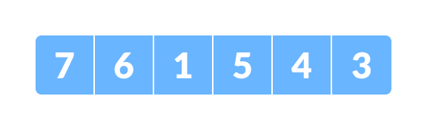
Merge Sort
05
EXAMPLE
12/26/2023
1. Let the given array be:

Slide 34
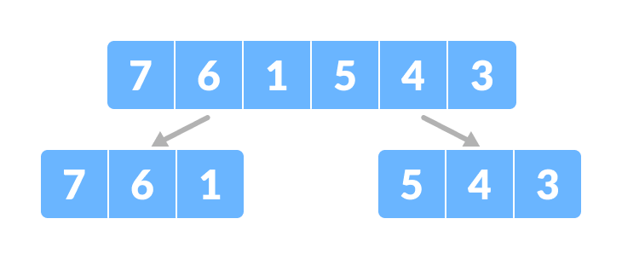
Merge Sort
05
EXAMPLE
12/26/2023
2. Divide the array into two halves.

Slide 35
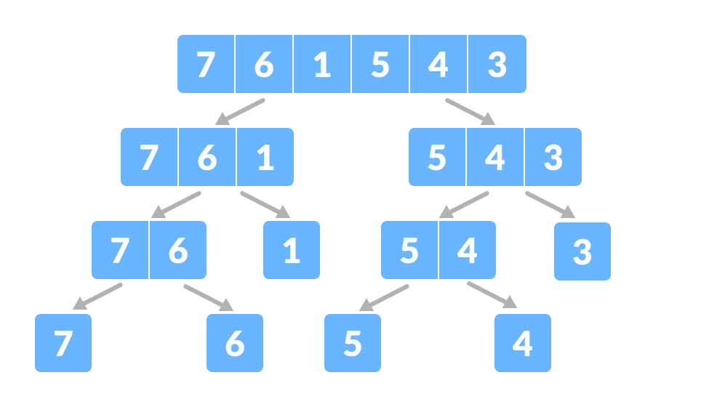
Merge Sort
05
EXAMPLE
12/26/2023
Again, divide each subpart recursively into two halves until you get individual elements.

Slide 36
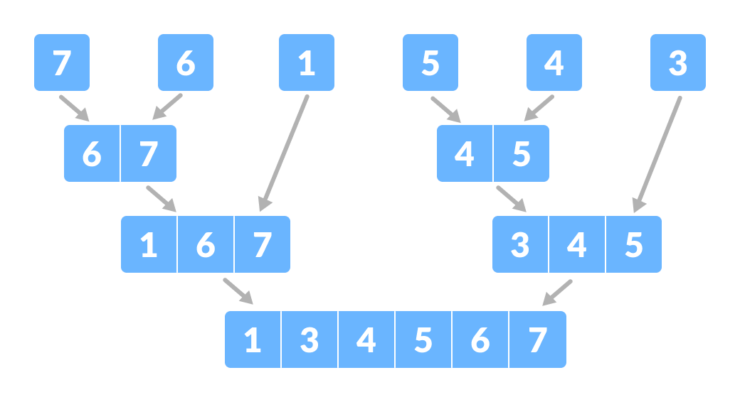
Merge Sort
05
EXAMPLE
12/26/2023
3. Now, combine the individual elements in a sorted manner. Here, conquer and combine steps go side by side.

Slide 37
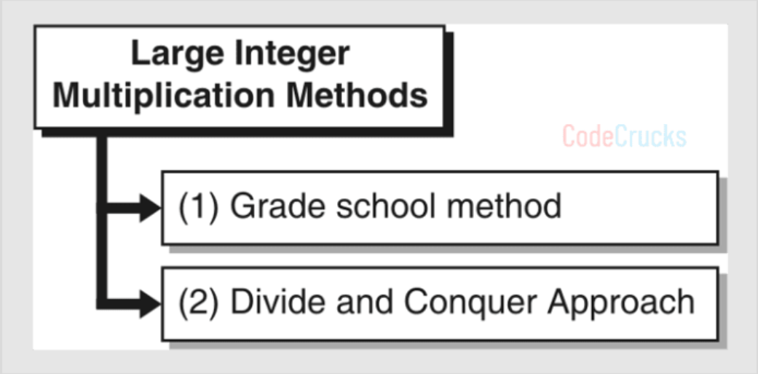
Large Integer Multiplication
05
EXAMPLE
12/26/2023
- Common procedure in computer-assisted problem solving. - Multiplying big numbers is not only difficult, but also time-consuming and error-prone.

Slide 38
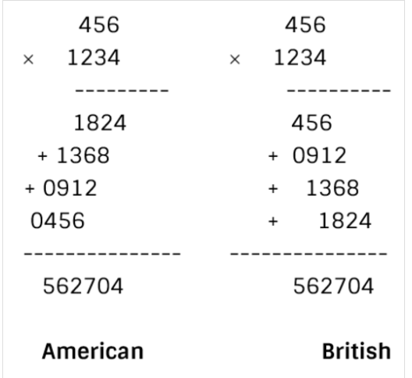


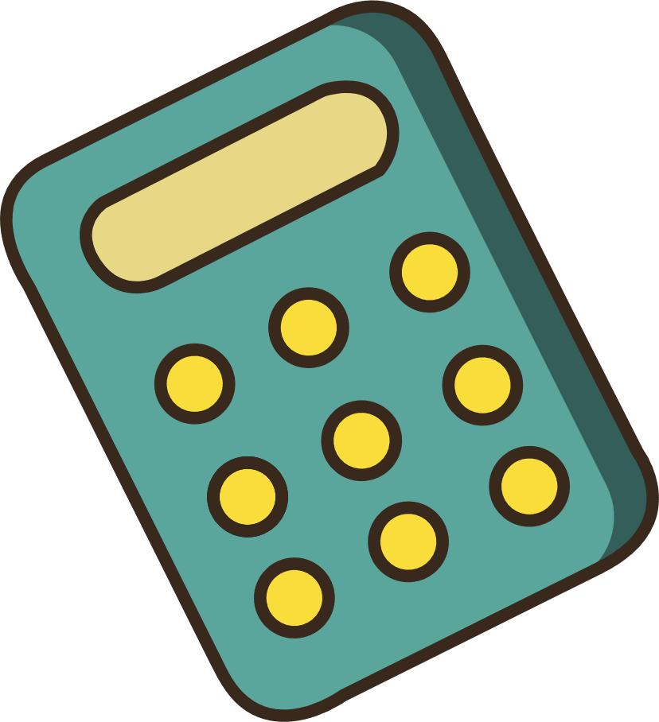
Traditional Multiplication Method.
05
EXAMPLE
12/26/2023

Slide 39

Traditional Multiplication Method.
05
EXAMPLE
12/26/2023
- time-consuming
- inefficient.
Complexity: O(mn)

Slide 40

Divide and Conquer Approach
05
EXAMPLE
12/26/2023
Suppose we have to multiply 2 integers of size 2n decimal places
By dividing a and b we can write a and b in the form
$$a = a1.10n + a2,$$
$$b = b1.10n +b2$$
in there
a₁, a₂, b₁, b₂ are n-digit numbers
Apply to the Karatsuba formula:
ab = a₁b₁ * 10^2n + [(a₁ + a₂)(b₁ + b₂) - a₁b₁ - a₂b₂] * 10^n + a₂b₂

Slide 41
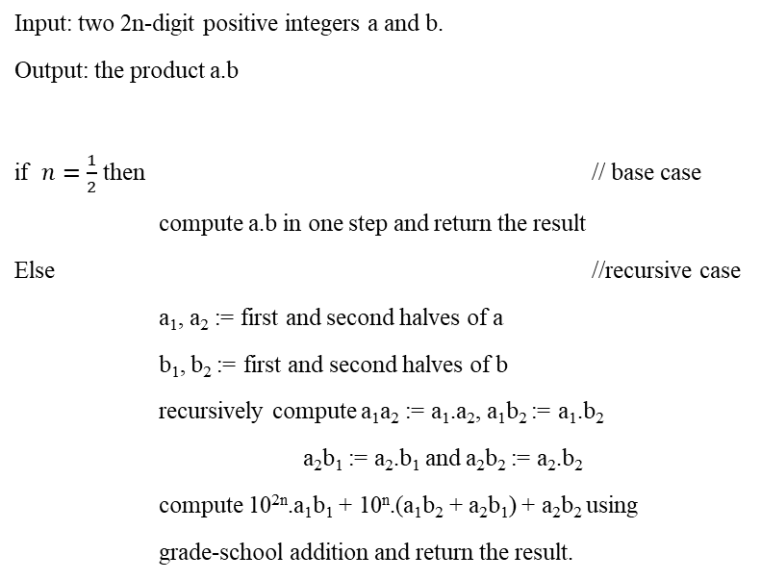
Pseudocode
05
EXAMPLE
12/26/2023
Input: two 2n-digit positive integers a and b.
Output: the product a.b
if $n=\frac{1}{2}$ then // base case
compute a.b in one step and return the result
Else //recursive case
a₁, a₂ := first and second halves of a
b₁, b₂ := first and second halves of b
recursively compute a₁a₂ := a₁.a₂, a₁b₂ := a₁.b₂
a₂b₁ := a₂.b₁ and a₂b₂ := a₂.b₂
compute 10^{2n}.a₁b₁ + 10^{n}.(a₁b₂ + a₂b₁) + a₂b₂ using
grade-school addition and return the result.

Slide 42

Divide and Conquer Approach
05
EXAMPLE
12/26/2023
For example: a= 5678 and b= 6789.
How about a better way?
a.b?
Time-consuming
Inefficient

Slide 43

Divide and Conquer Approach
05
EXAMPLE
12/26/2023
For example: a= 5678 and b= 6789.
1. Our algorithm separates the terms into
a₁ = 56, a₂ = 78, b₁ = 67 and b₂ = 89.
2. Three halves multiplications that
need to be performed are:
p = a₁b₁ = 56 × 67 = 3752
q = a₂b₂ = 78 × 89 = 6942
and
r = (a₁ + a₂) × (b₁ + b₂) = 134 × 156= 20904

Slide 44
Divide and Conquer Approach
05
EXAMPLE
12/26/2023
For example: a= 5678 and b= 6789.
Therefore
ab = 3752*10000 + (20904 - 3752 - 6942)* 100 + 6942
= 3752 0000 + 10210 00+ 6942
= 38547942
We have:
a x b = (a₁ 10^{n} + a₂)( b₁ 10^{n} +b₂)
= a₁b₁10^{2n} + (a₁b₂ + a₂b₁) 10^{n} + a₂b₂

Slide 45
Divide and Conquer Approach
05
EXAMPLE
12/26/2023
For example: a= 5678 and b= 6789.
So we have seen a multiplication with 2n digits about 4 multiplication with n digits and
2 additions.
Complexity: O(n^1.59)

Slide 46

06
Q&A
12/26/2023

Slide 47
QUIZ
06
Q&A
12/26/2023
In the divide and conquer process, breaking the problem into smaller sub-problems is the responsibility of
A. Sorting/Divide
B. Conquer/Solve
C. Merge/Combine
D. Divide/Break

Slide 48
QUIZ
06
Q&A
12/26/2023
The running time of merge sort can be reccursively represented by
A. T(n)=2T(n/2)+O(n)
B. T(n)=2T(n/4)+O(n)
C. T(n)=3T(n/2)+O(n)
D. T(n)=3T(n/2)+O(n)

Slide 49

06
Q&A
Q&A
any question?

Slide 50

THANK YOU FOR YOUR WATCHING
12/26/2023

